Slide 1
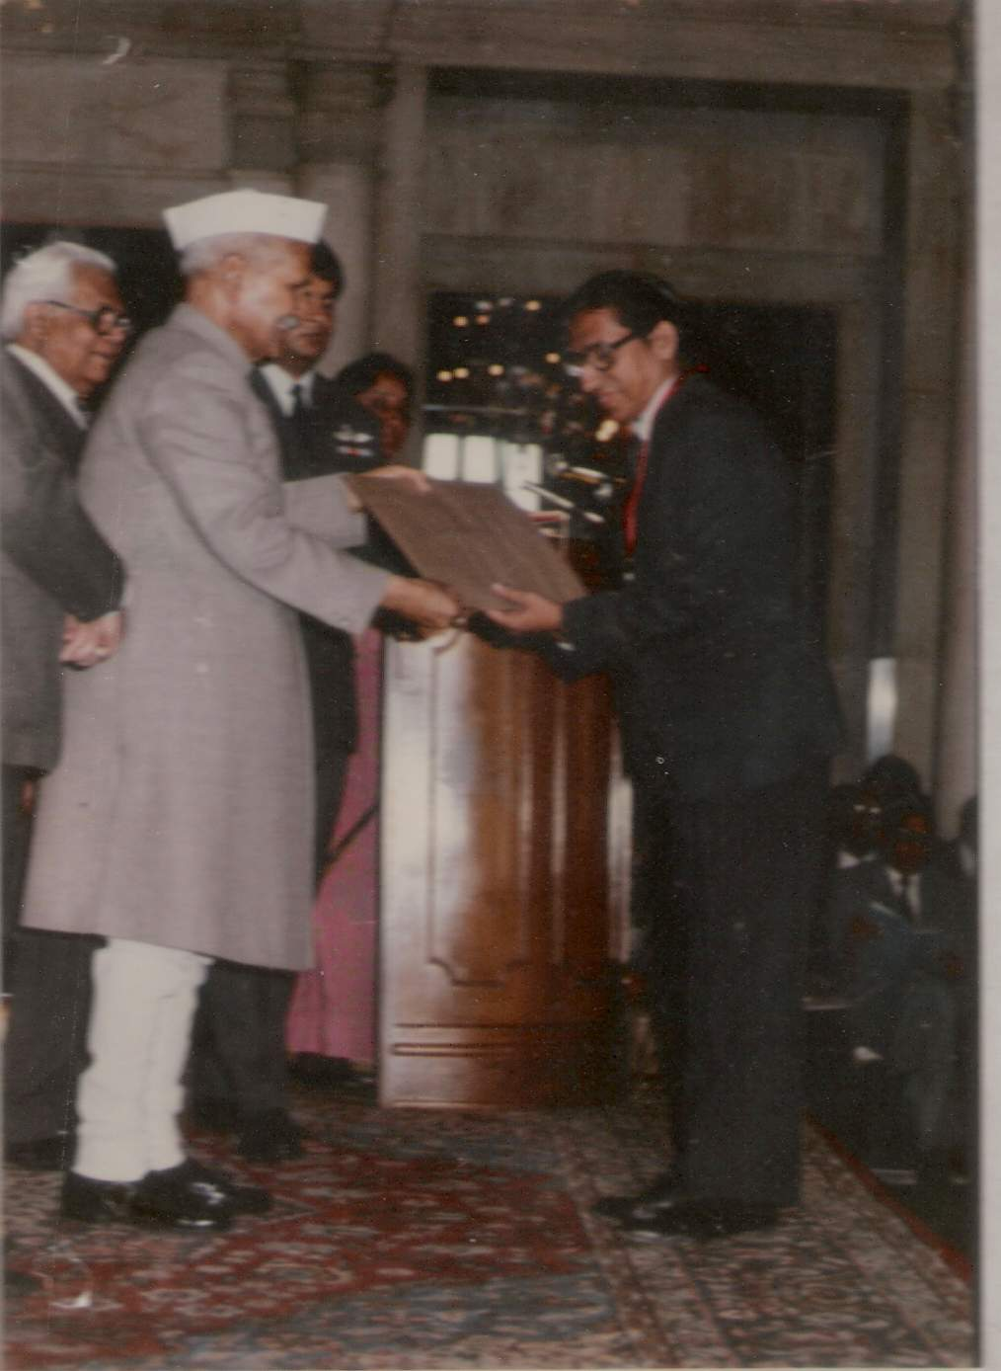
50 years of Karmayoga
By
D.M. Vasudevan, MD, FRCPath

Slide 2
Academic:
50 years teaching and research
Worked in 8 medical colleges
Founder Dean, Sikkim Manipal Institute of Medical Sciences, Gangtok, Sikkim
Founder Principal, Amrita Institute of Medical Sciences, Kochi
Founder Head, Cancer Research Dept at Regional Cancer Centre, Trivandrum (1979-82)
Founder Head, Cancer Research Laboratory at Amala Cancer Research Centre (1982 to 87)

Slide 3
AWARDS AND HONOURS:
Dr. B.C. Roy Award for Eminent Medical Teacher, (Indian Medical Council), 1992, received from the President of India.
Fellow, National Academy of Medical Sciences, (FAMS), 1992.
Past President, Association of Clinical Biochemists of India (ACBI)
Fellow, Association of Clinical Biochemists of India (FACBI), 2010

Slide 4
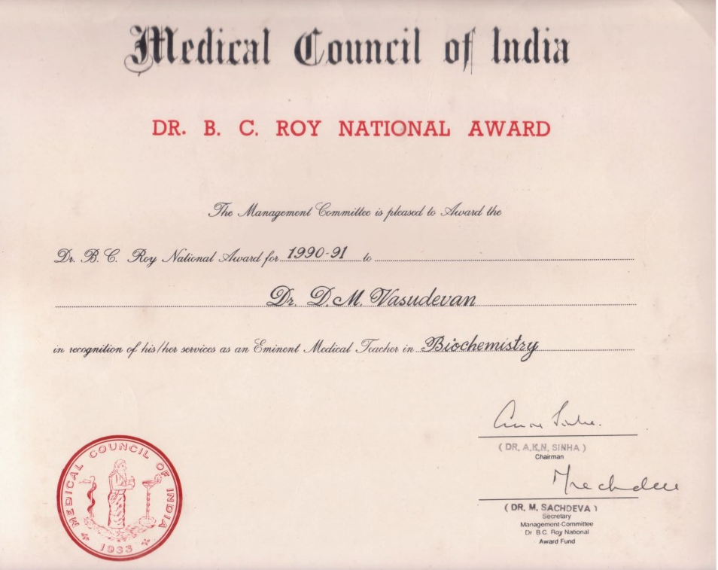

Slide 5
Students
PhD students > 30
MD / MSc students > 300
MLT students > 400
MBBS students > 2500
Students purchased text books 4,00,000

Slide 6
Research
30+ PhD students
245 Research papers
5374 Citations

Slide 7
Research Experience
69 to 71: Post graduate Fellow, AIIMS, New Delhi
72 to 74: Post-doctoral Research Fellow at Institute of Cancer Research, Switzerland
1980: Short term visiting Scientist, Chester Beatty Cancer Research Institute, London, with the Fellowship of International Union Against Cancer
1985: Uniformed Services University of Health Sciences, Bethesda, Maryland, USA, with the help of Fogarty Foundation Travel Fellowship.

Slide 8
Textbook of Biochemistry for Medical Students
now in 8th edition
more than 4,00,000 copies sold
widely used in all medical colleges in India and 22 other countries abroad;
Spanish and Slovak editions are also available. Russian edition is in preparation

Slide 9
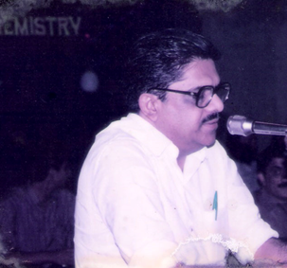
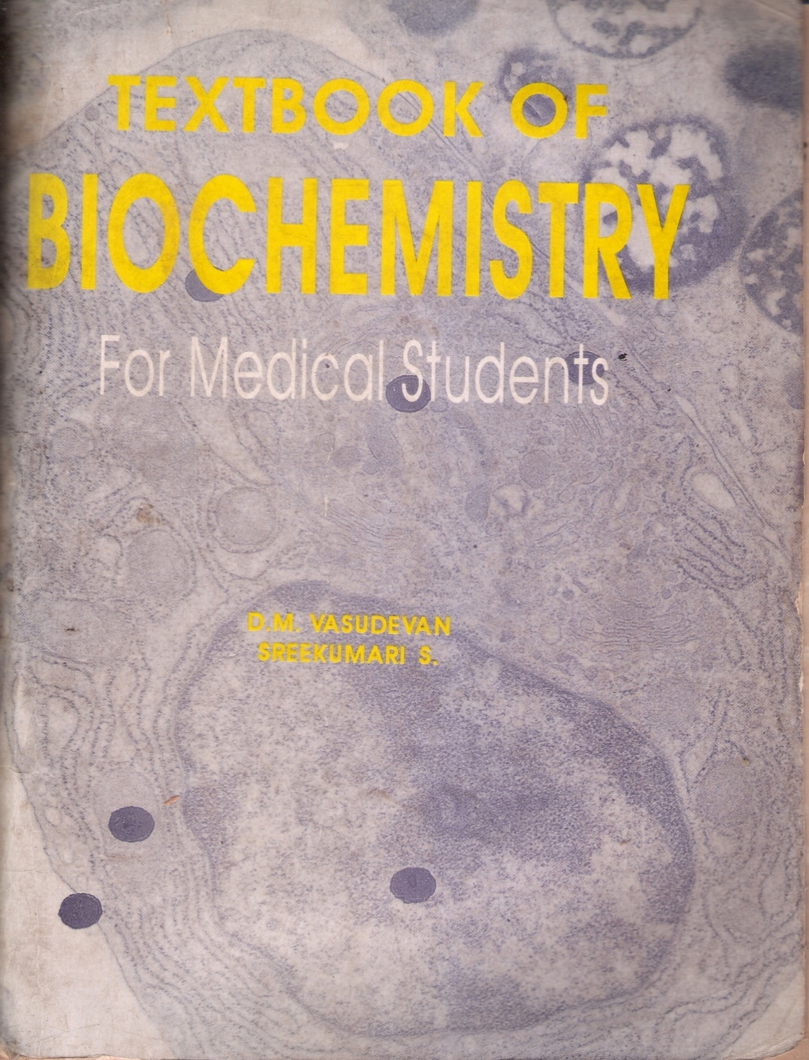
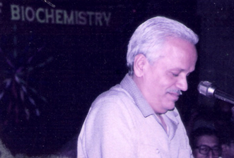
1995, 1st ed
Trissur Med College.
Health Minister
to Vice Chancellor

Slide 10
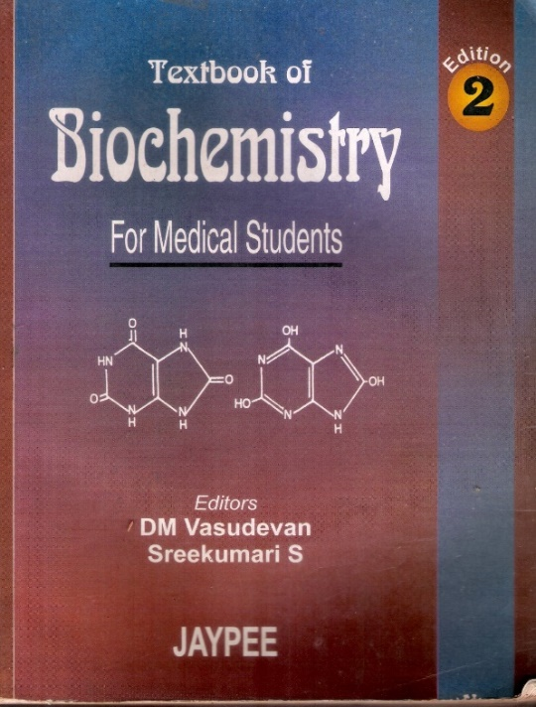
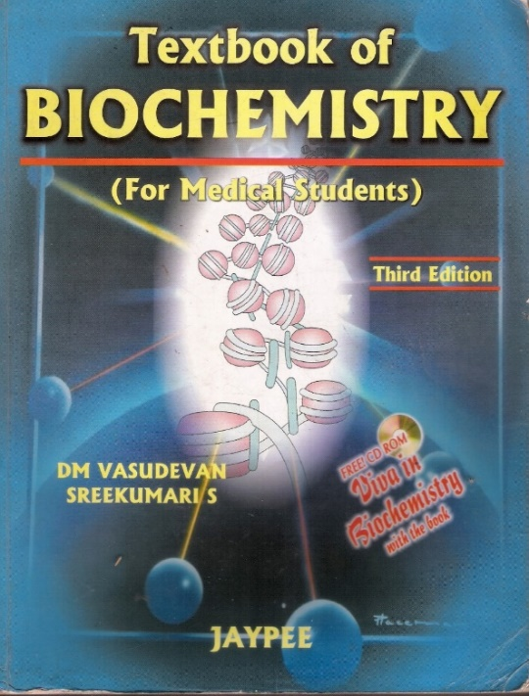
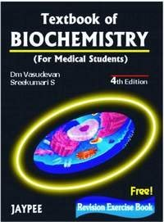
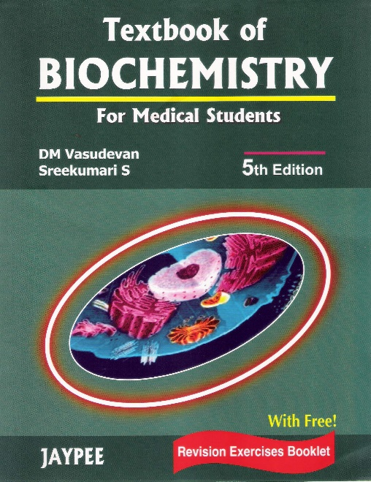
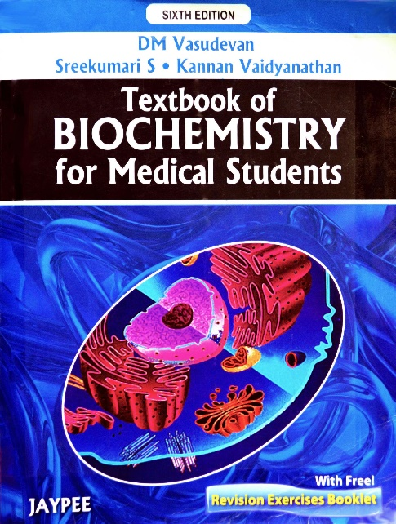
1st ed, 1995 2nd ed, 1998 3rd ed, 2001
4th ed, 2004 5th ed, 2007 6th ed, 2010

Slide 11
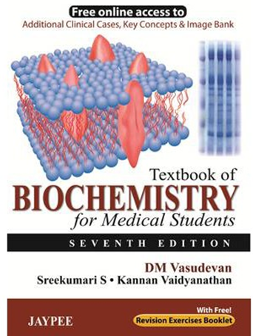
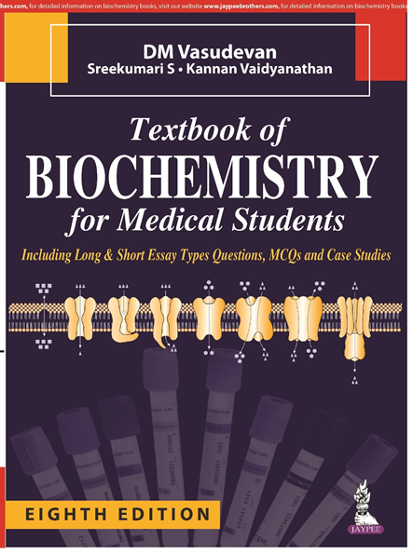
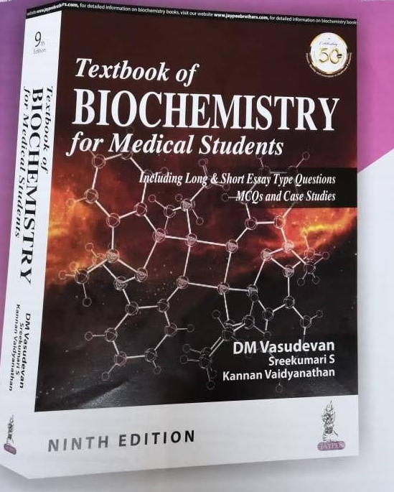
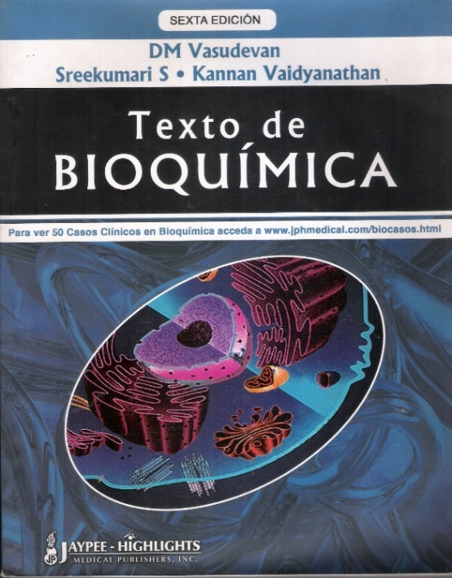
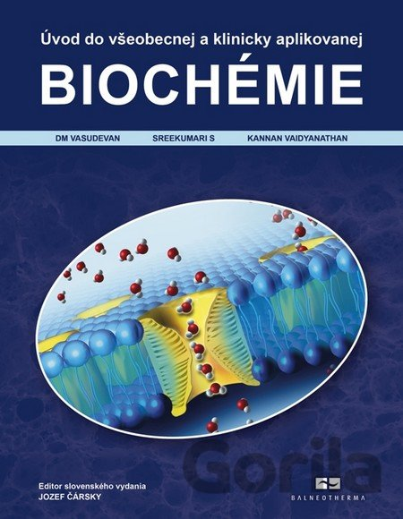
7th ed, 2013 8th ed, 2016 9th ed, 2019
Spanish
Edition
2011
Slovak
Edition
2014

Slide 12
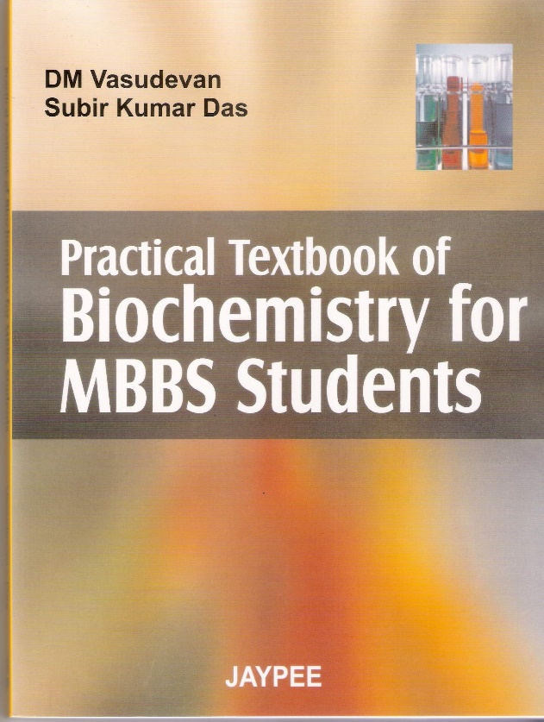
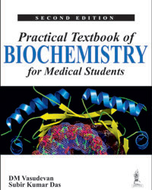
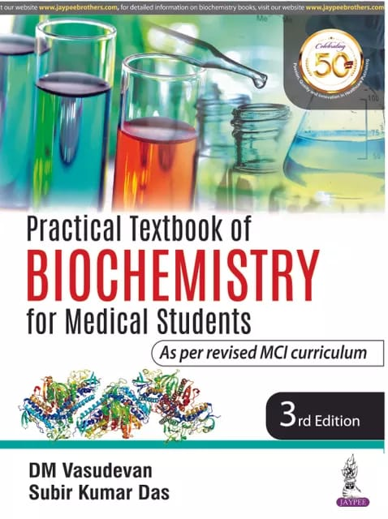
Practical Textbook for MBBS Students
1st ed, 2006 2nd ed, 2013 3rd ed, 2019

Slide 13
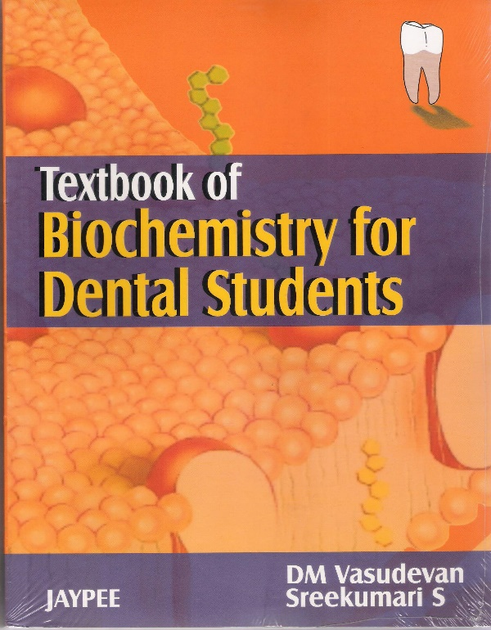
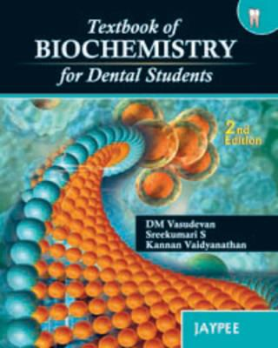
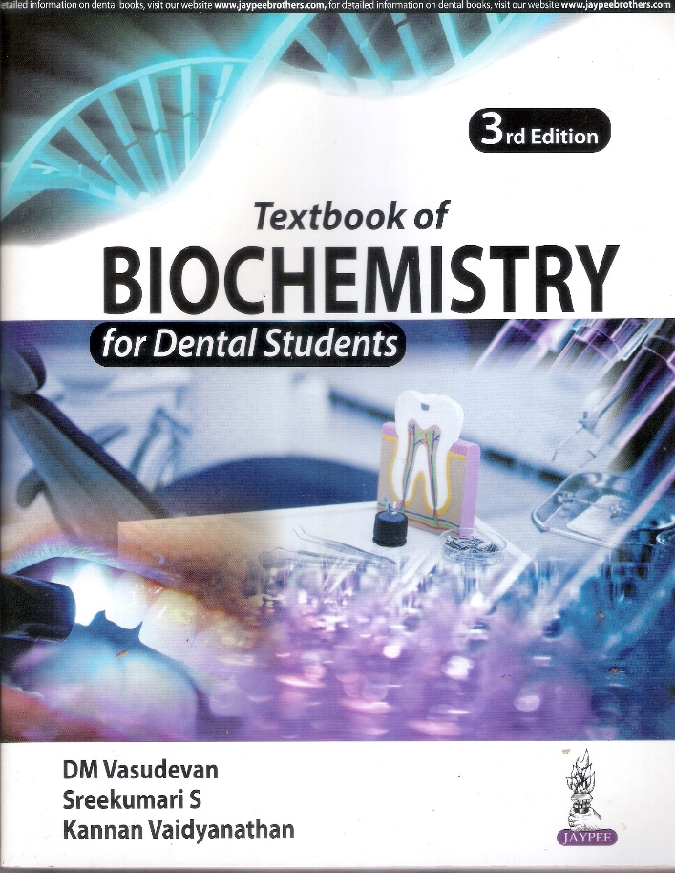
Text book of Biochemistry for
Dental Students
1st Ed 2006 2nd ed 2012 3rd ed 2018

Slide 14
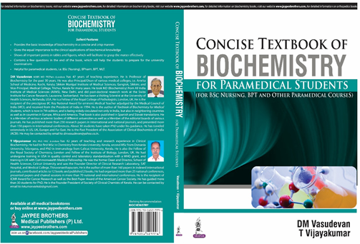
Concise Textbook of Biochemistry for paramedical students
1st Edition, 2015.

Slide 15
Students now in eminent positions
V.K. Sasidharan, Head, Department of Life Sciences, University of Calicut
S. Vivekanandhan: Professor of Biochemistry, All India Institute of Medical Sciences, Rishikesh
Ravindran Ankathil: Professor, Human Genome Center, School of Medical Sciences, Health Campus, University Sains Malaysia, Malaysia.
Suresh Kalathil: Professor of Immunology, Roswell Park Cancer Institute, Buffalo, New York

Slide 16
P.N.Raghunath: Head and Professor of Pathology Lab, Department of Medicine, University of Pennsylvania Pennsylvania, USA.
Mrs. Minnie Pillay: Professor and Head, Department of Anatomy, Amrita Medical College, Kochi.
K.K. Elyas: Director School of Health Sciences University of Calicut
Subir Kumar Das: Professor, College of Medicine and JNM Hospital, WBUHS, Kalyani, Nadia, West Bengal.
Sukhes Mukherjee :All India Institute of Medical Sciences Bhopal

Slide 17
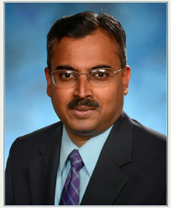
Dr. Shyamsundaran Kottilil, MBBS, PhD
Co-Director, Institute of Human Virology,
National Institutes of Health (NIH);
Bethesda, MD-20892, USA

Slide 18
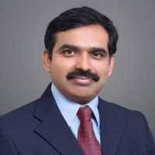
Dr. Valsraj Menon, MBBS, MRCP
Consultant
Department of Psychiatry,
East London NHS Foundation Trust, London, UK.

Slide 19
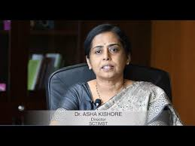
Dr. Asha Kishore, MBBS, PhD
Director
Sree Chithra Tirunal Institute of Medical Science and Technology, Trivandrum

Slide 20
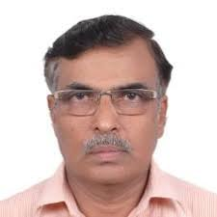
Dr. S. Vivekanandhan, PhD
Professor of Biochemistry,
All India Institute of Medical Sciences, Rishikesh

Slide 21
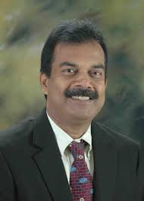
Dr. Ravindran Ankathil, PhD
Professor, Human Genome Center,
School of Medical Sciences,
University Sains Malaysia,
Kelantan, Malaysia.

Slide 22
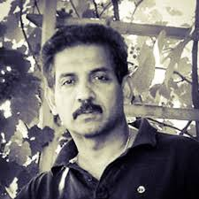
Dr. Suresh Kalathil, PhD
Professor of Immunology, Roswell Park Cancer Institute, Buffalo, New York

Slide 23
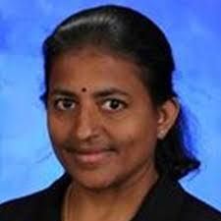
Dr. Kala Venkateswaran, PhD
Lerner Research Institute, Cleveland Clinic Foundation, Cleveland, Ohio, USA

Slide 24
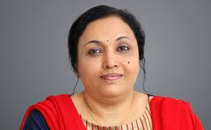
Dr. Minnie Pillay, PhD
Professor and Head,
Department of Anatomy,
Amrita Medical College, Kochi

Slide 25
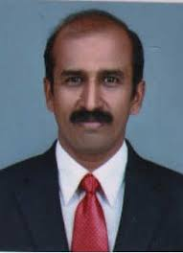
Dr. K.K. Elyas, PhD
Director
School of Health Sciences University of Calicut

Slide 26
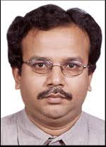
Dr. Subir Kumar Das, PhD
Professor of Biochemistr
College of Medicine and JNM Hospital WBUHS, Kalyani,
Nadia, West Bengal

Slide 27
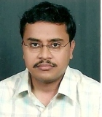
Dr. Sukhes Mukherjee, PhD (Clinical Biochemistry, Distinction & 1st rank in Post graduation (Medical Biochemistry)
All India Institute of Medical Sciences
Bhopal

